Slide 1

L.J. INSTITUTE OF COMPUTER APPLICATIONS
Guided By:- Prof. Krupa ma’am

Slide 2
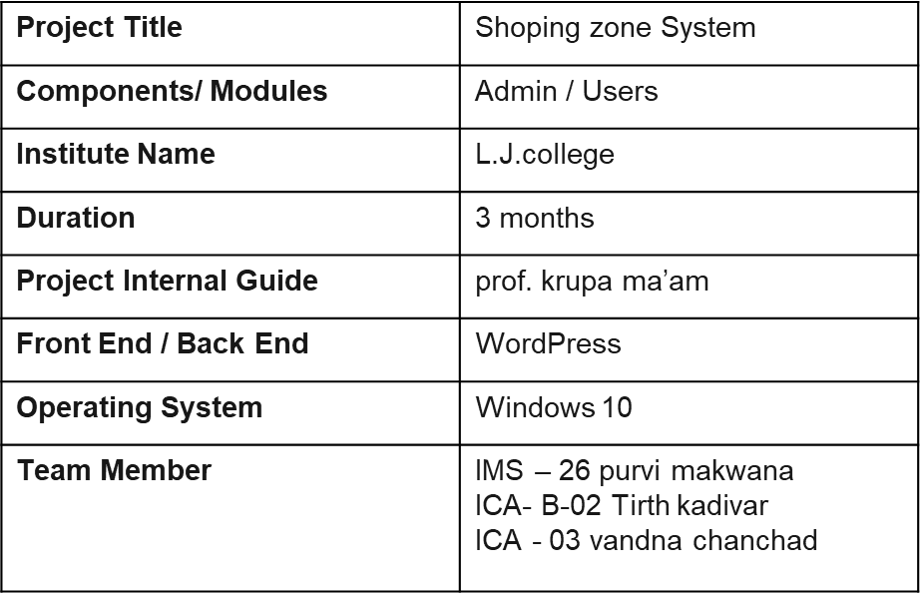
PROJECT PROFILE:

Slide 3
TABLE OF CONTENTS
1. Introduction
1.1 Existing System
1.2 Needs of the New System
1.3 objective of the New System
1.4 problem Definition
1.5 core components
1.6 project profile
2. Requirement Determination & analysis
2.1 Targeted user
2.2 Feasibility Analysis
3. System design
3.1 Use case diagram
3.2 class Diagram
3.4 data dictionary
3.5 User Interface
3.6 Report Design
4. Development
4.1 Coding Standards
5. Testing
5.1 unit testing
5.2 Integration Testing
6. Proposed enhancement
6.1Proposed enhancement
7. conclusion
7.1 conclusion
8. bibliography
8.1bibliography

Slide 4
1. INTRODUCTION:
In the present time the Shopping stores are looking for the service that are accurate and reliable for providing services to the customers and workers every store is making efforts to computerize their activities for providing better services to the customer. The online shopping store management system is the system used for All inventory in the universal stores .This system enable the manager of the store to record and manage all activities of the Useful Shop

Slide 5
EXISTING SYSTEM:
There is no existing system.
The Firm advertises products and takes orders from social media platforms.
Every work is done manually, from record-keeping to report generation .
It is difficult for everyone to manage the records of the orders and responses. The Firm can advertise only limited products due to dependency on another platform.

Slide 6
NEED FOR NEW SYSTEM:
Nowadays, in this rapidly digitalizing world it is very important to upgrade our business and take it on our own digitalized platform to expand the business and track and analyze the records more easily and efficiently.
In the current system it’s hard to manage and keep track of records of the orders as they’re all from different social media platforms
It’s hard to expand the product range in the current system process as it will be difficult to manage them.
The business can expand its reach to the customers but due to lack of digitalization, it is limited to an extent.
In the current process it's difficult to improve the products as per the customer’s needs due to a lack of overall business analysis.

Slide 7
OBJECTIVE OF NEW SYSTEM:
DIGITALIZATION:
To take the extent of the business to the next level using digitalization.
To improve the availability of services and accessibility by a digital platform.
EASY INTERACTION:
To provide the facility of easy interaction with the customer.
To get support from the business easily to the customer.
MAINTAIN RECORD:
To record, maintain and analyze the records of the business.
To work on improvement of the business as per the analyzed records.
BUSINESS EXPANSION:
To get more customer traffic and advertising to business.
To increase sales of the business.

Slide 8
PROBLEM DEFINATION:
It’s hard to manage the inventory and orders and the record keeping which is all done manually. The new system will allow the firm to add as many products as it wants due to flexibility of the inventory management and manage the order very easily & rapidly with the help of order management.
Getting onto customers’ feedback, queries, reviews, request, etc is hard due to the unorganized lifecycle of the system’s process. The new system will provide a organized way to get back to customers' with the help of feedback management feedback, queries, reviews, request, etc.
The firm is not completely able to provide its best to the customers due to a lack of platform independence. This system new will give the firm an independent platform so it can be molded and presented in will of the business.

Slide 9
CORE COMPONENTS:
1. User :-
Registration :- User can Register.
Login :- User can Login.
View Product :- User can View Product .
Add to cart :- User can Booking Add to cart .
Order product :- User can order the product
Logout :- User can Logout.
2. Admin :-
Manage Product :- Admin can Manage the Product .
Manage inventory : Admin can mange inventory
Manage order :- Admin can manage order
Manage User : Admin can manage user
Manage Feedback : Admin can view and manage the feedback of customer.
Manage Staff : Admin can manage staff.
Manage Report : Admin can manage reports.
MANAGE OFFERS : Admin can manage offers.

Slide 10
Requirement Determination and Analysis:
TARGETED USERS:
● ADMIN
● USER WITH MUTUAL INTEREST WHO ARE LEGALLY ALLOWED.

Slide 11
REQUIREMENT DETERMINATION:
➔ CLIENT SIDE
◆ HARDWARE REQUIREMENT:
● PROCESSOR: 1.8GHZ(Min.)
● RAM: 2GB(Min)
● INTERNET: 512KBPS(Min)
◆ SOFTWARE REQUIREMENT:
● ENABLED BROWSER
➔ SERVER SIDE
◆ HARDWARE REQUIREMENT:
● PROCESSOR: 3GHZ(Min.)
● RAM: 4GB(Min)
● HARD DISK: 2GB(Min)
◆ SOFTWARE REQUIREMENT:
● LINUX OPERATING SYSTEM

Slide 12
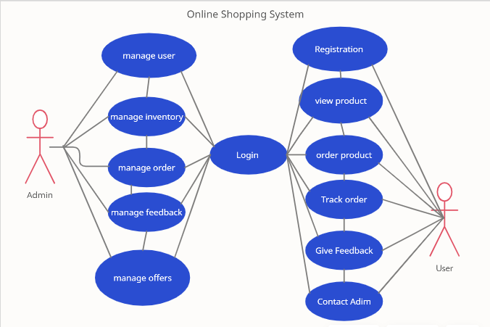
Use case diagram:

Slide 13
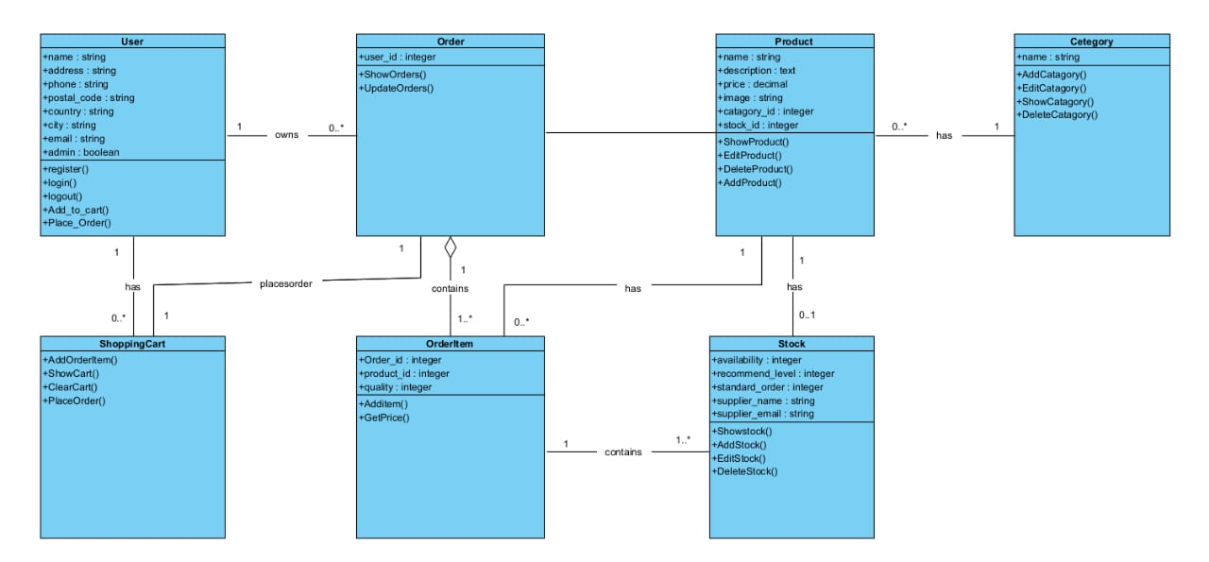
CLASS DIAGRAM:

Slide 14
Data Dictionary:
1. Table Name :- Registration
Field | Type | Size | Constraint | Description | Example
User_id | Int | 11 | Primary_key | Id of user | 1
F_name | Varchar | 50 | - | First Name of user | Mansi
L_name | Varchar | 30 | - | Last Name of user | Patel
Email | Varchar | 20 | Unique_key | Email-id of user | abc@gmail.com
Username | Varchar | 20 | Unique_key | Username | Abcd
Password | Varchar | 15 | - | Password | 1234

Slide 15
2. Table Name: Login
3. Table Name: Order
Field | Type | Size | Constraint | Description | Example
User Name | Varchar | 20 | - | Name of user | Mansi
E-mail | Varchar | 20 | - | User Email id | Mansi@gmail.com
Password | varchar | 15 | - | Password | mansi233
Field | Type | Size | Constraint | Description | Example
Booking_id | Int | 15 | Primary_Key | Id of booking | 7996
Booking _id | Varchar | 50 | Foreign_key | Id of booking | 22242
booked_date | Date | - | Date | Date of Order | 22-07-2021
Customer_name | Varchar | 15 | - | Name of Customer | Mansi

Slide 16
Interface:
The two interface types found in the online shopping-cart application are as follows:
1. User Interface:
Users are able to view the home page of the shopping-cart application, browse the different categories, browse and add any number of items from any categories in the shopping cart, look for information about each product, delete the items in the shopping cart, save the cart for later viewing, check out or continue shopping after adding the item to the cart, and check out the items by completing the required information in the order form.
2. Admin Interface:
The administrator is able to view the users’ information that was entered during checkout in the database, can update the information, price, shipping costs of the items, add or remove items from the main display.

Slide 17
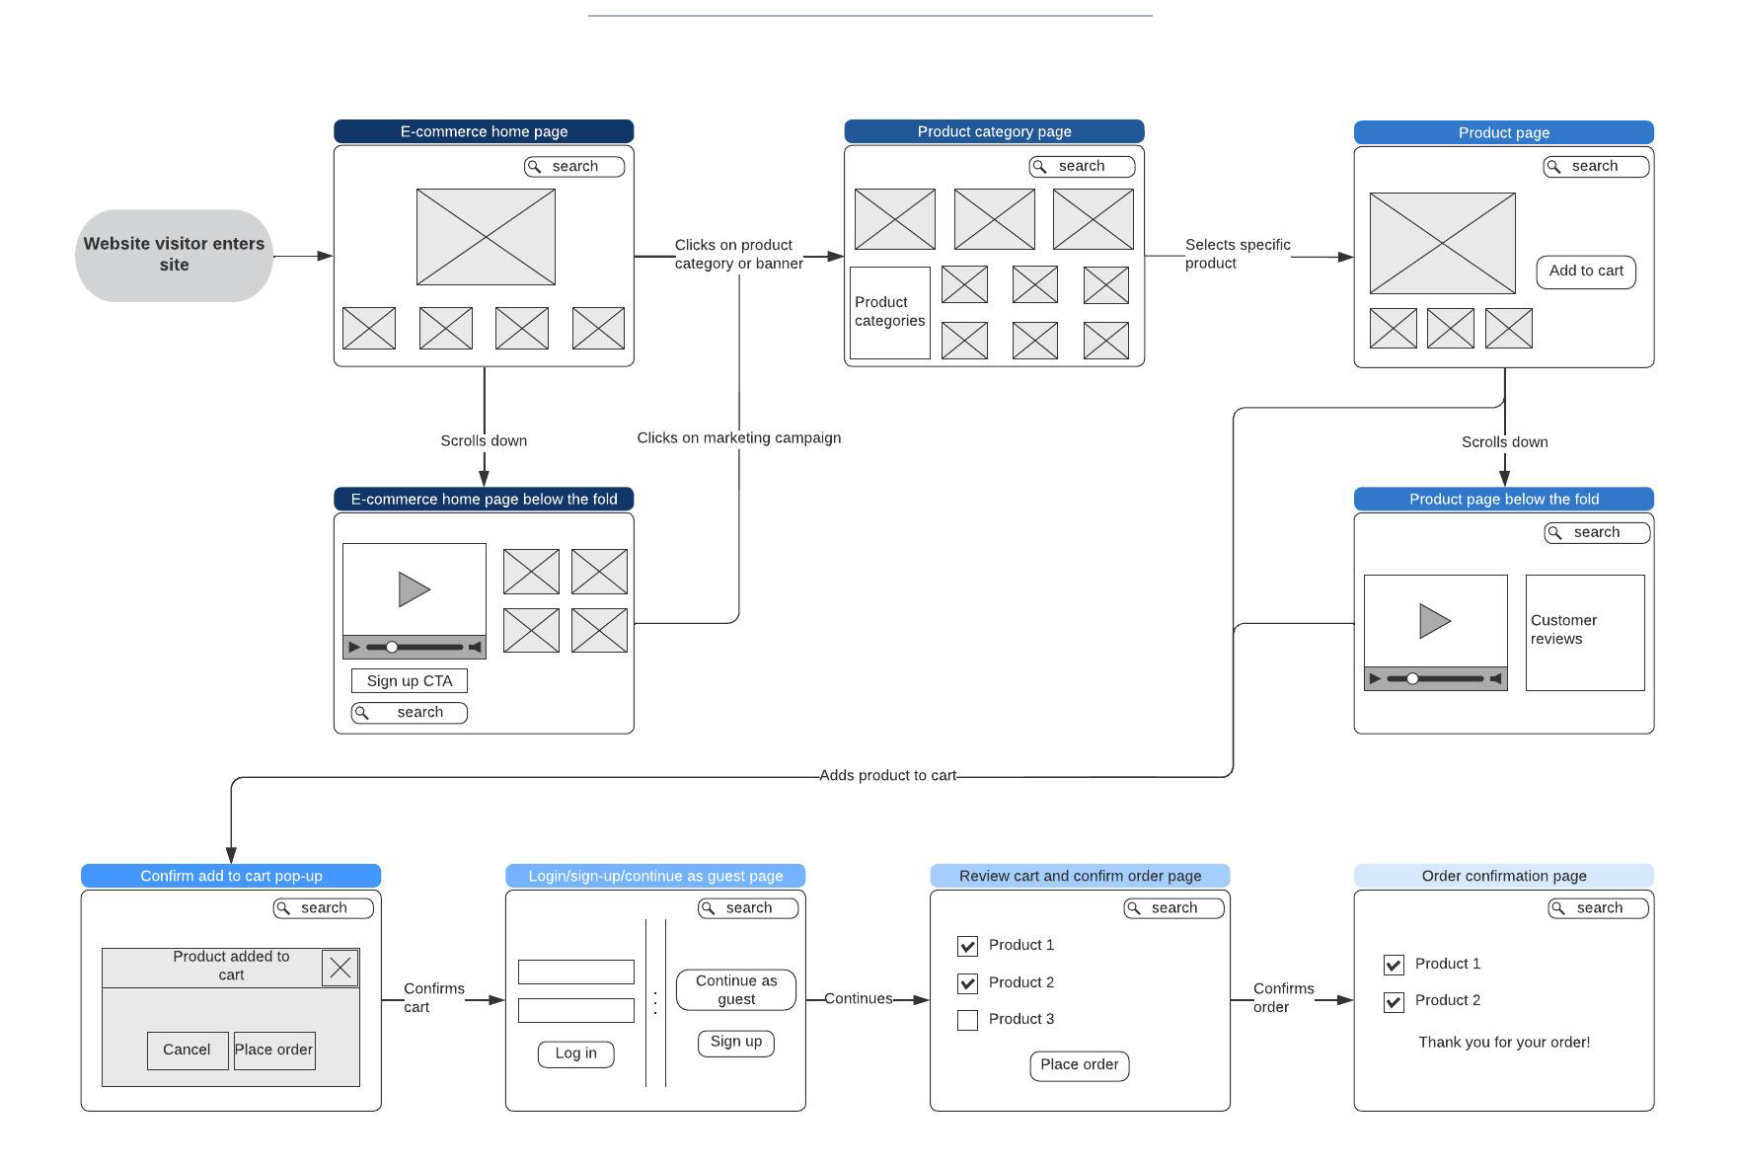
Development:
Navigation:

Slide 18
TESTING:
Software testing is a process of running with intent of finding errors in software.
Software testing assures the quality of software and represents final review of other phases of software like specification, design, code generation etc.
Unit Testing:
Unit testing emphasizes the verification effort on the smallest unit of software design
i.e.; a software component or module. Unit testing is a dynamic method for verification, where program is actually compiled and executed.
Integration Testing:
In integration testing a system consisting of different modules is tested for
problems arising from component interaction. Integration testing should be developed from the system specification.

Slide 19
Proposed Enhancement:
Advertisement of new product
Notification of User cart , sales , discount offer etc.

Slide 20
Conclusion :
In our opinion, you can go for online fashion hub only if you are searching for low range products and that too with cash on delivery option .For buying product with greater cost ,you must try to visit the standardized shop outside and bargain for the best price . In this case ,if anything goes wrong ,you can directly complain to the person from whom you had purchased the product .

Slide 21
Bibliography:
Website :-
https://www.youtube.com/watch?v=w0YxylKDMKw

Slide 22
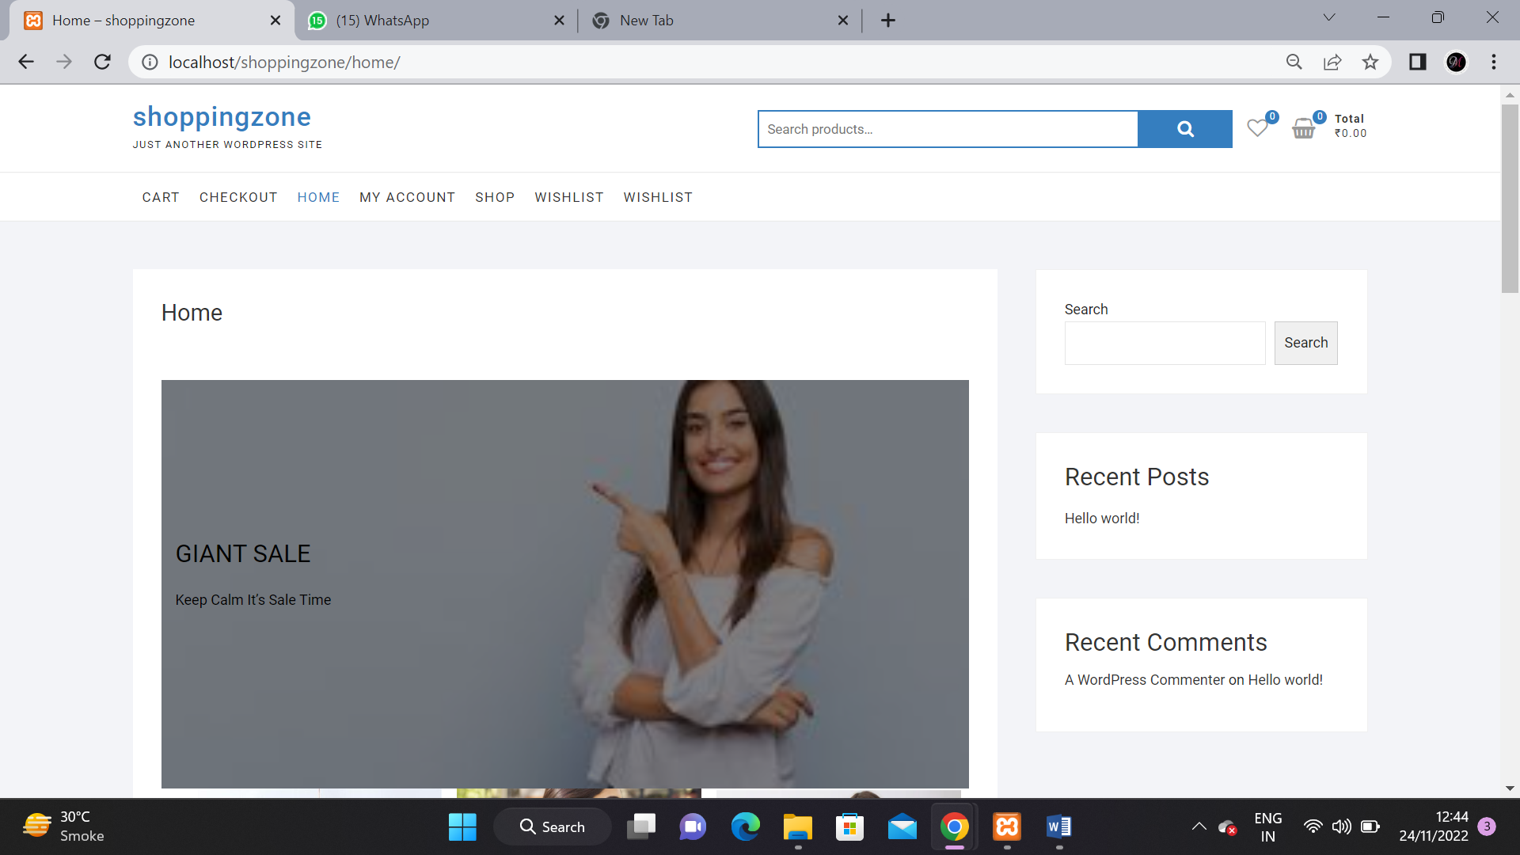
Screenshots:
Home:

Slide 23
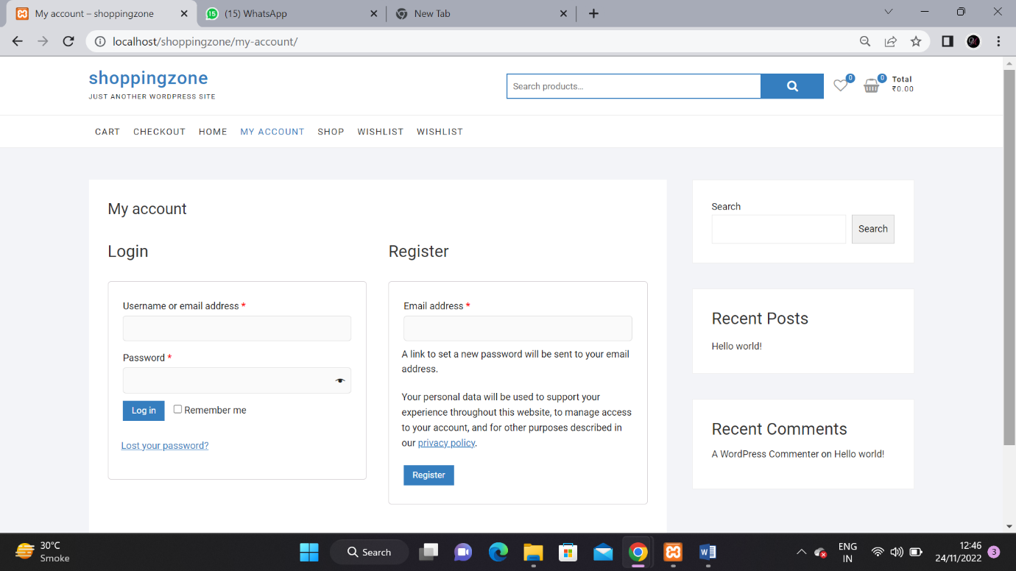
My Account:

Slide 24
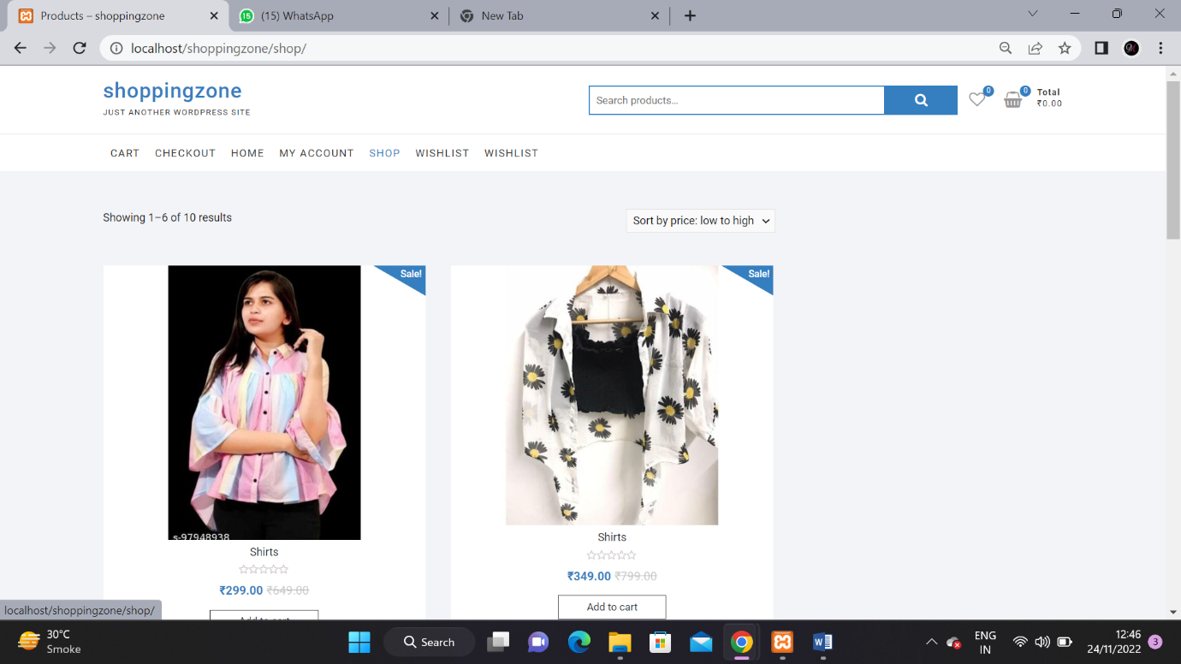
Shop:

Slide 25
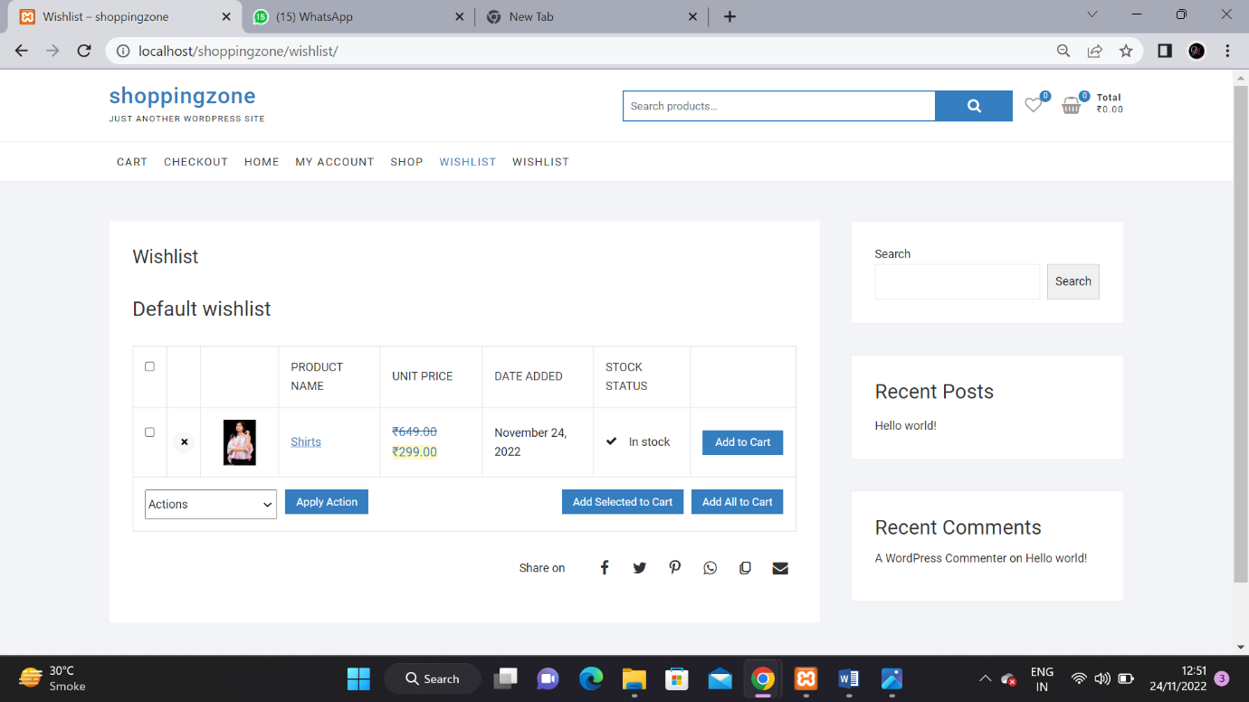
Wishlist:

Slide 26
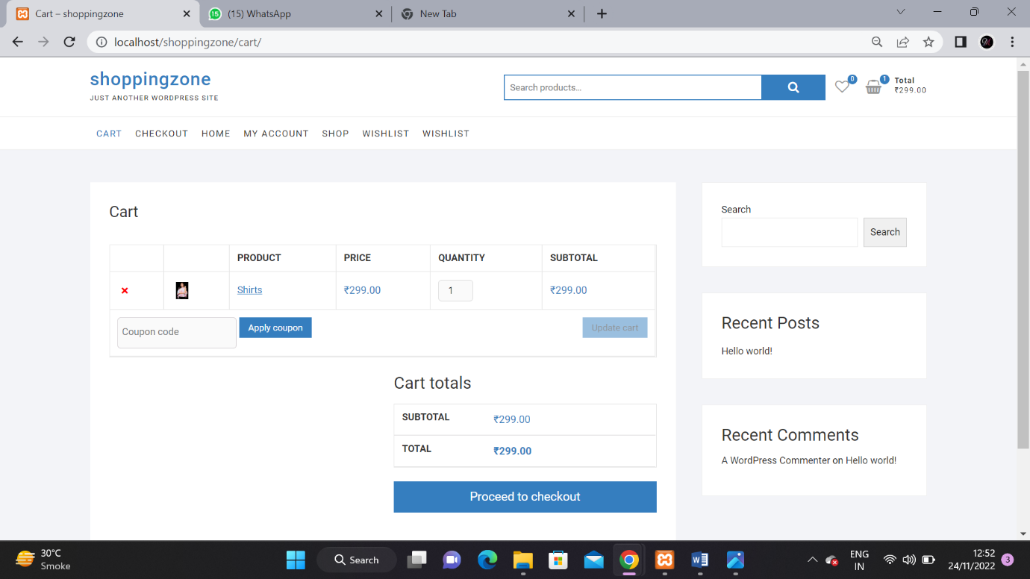
Cart:

Slide 27
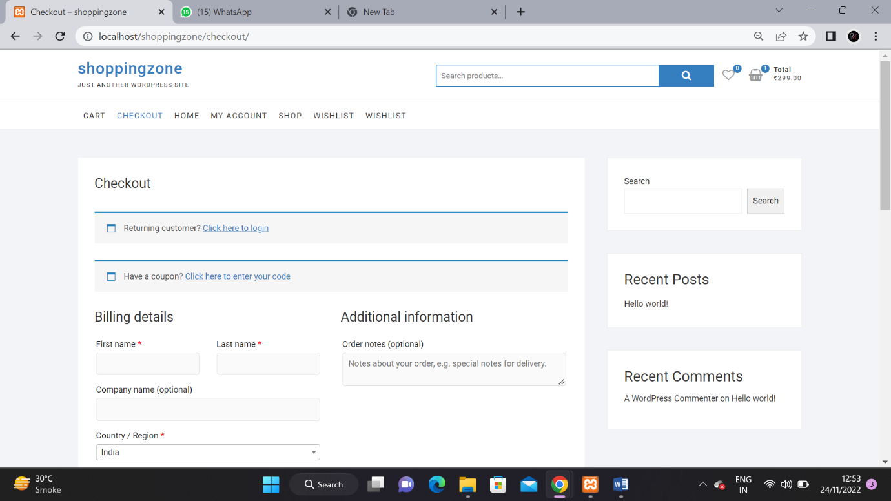
Checkout:

Slide 28
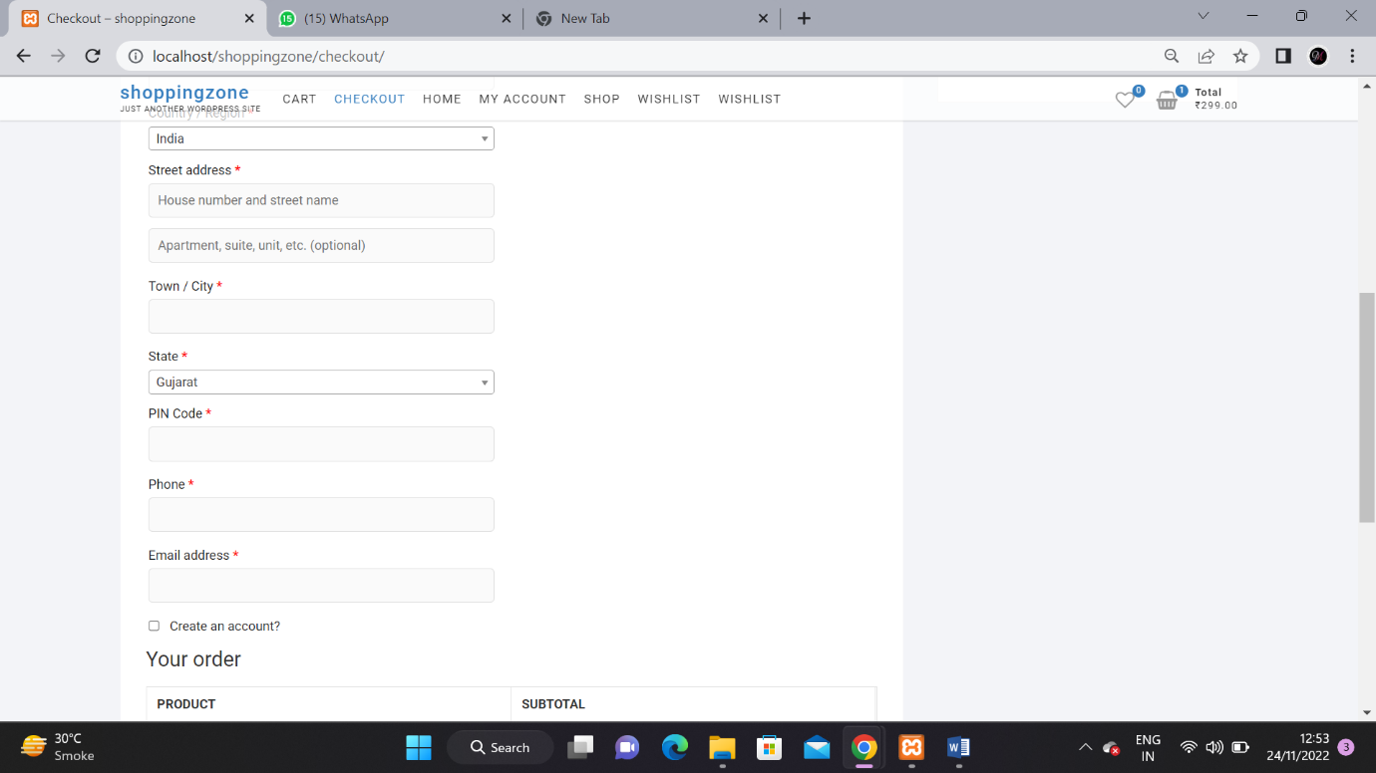

Slide 29
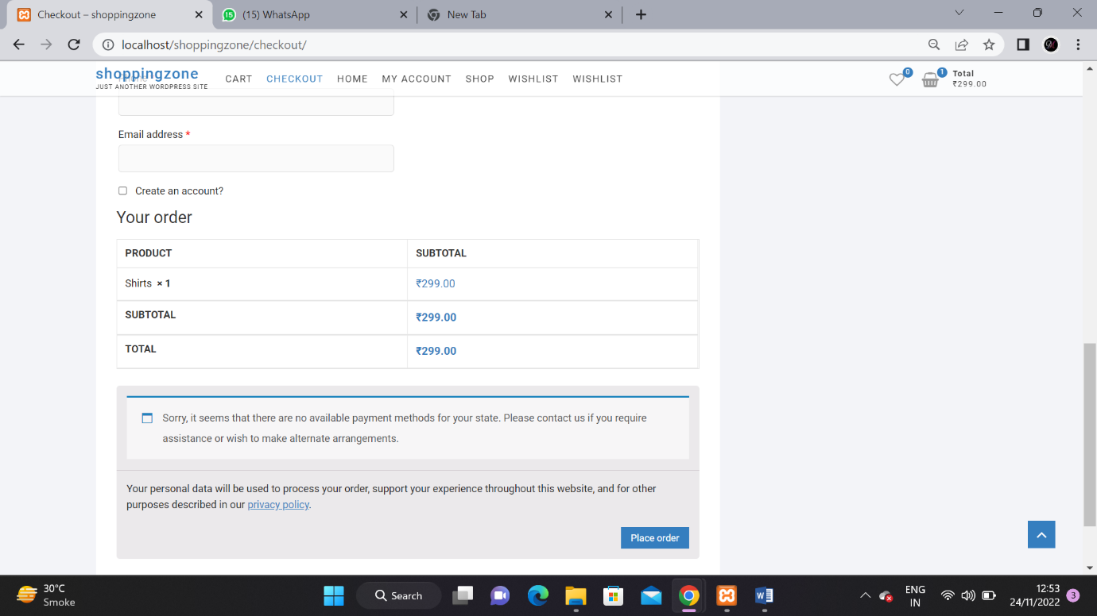

Slide 30
thank YOU SO MUCH

